Slide 1
ARRAY PROCESSORS
SIMD Computer Organization
Compiled by
Dr. N. Gopalakrishna Kini
Professor, Dept. of CSE
MIT, Manipal

Slide 2
A synchronous array of parallel processors is called an array processor, which consists of PEs under the supervision of one control unit (CU).
The function of CU is to decode all the instrns and to determine whether and where the decoded instruction should be executed.

Slide 3
SIMD Computer Organization:
I/O Instruction and data
CU memory
CU
Control
CP
Data bus
PE0
PEM0
PE1
PEM1
PEN-1
PEMN-1
Interconnection N/W
CONFIG I

Slide 4
This configuration is implemented in Illiac-IV computer.
Consists of N synchronized PE’S, all of which are under the control of one CU.
The CU has its own memory for the storage of programs.
The system and user programs are executed under the control of the CU.
Scalar or control type instructions are directly executed by the CPU.
Vector instructions are broadcast to the PE’s.
Interconnection n/w is responsible for inter-PE communication.

Slide 5
Config II:
I/O
CU memory
CU
PE0
PE1
PEN-1
Alignment Network
Data Bus
M0
M1
Mp-1

Slide 6
5.1 SIMD Organization (continued)
Control processor
  To fetch instructions and decode them
  To transfer instructions to PEs for executions
  To perform all address computations
  To retrieve some data elements from the memory
  To broadcast them to all PEs as required.

Slide 7
5.1 SIMD Organization (continued)
Arithmetic/Logic processors
  To perform the arithmetic and logical operations on the data
  Each PE corresponding to data paths and arithmetic/logic units of an SISD processor capable of responding to control signals from the control unit.

Slide 8
Formally, an SIMD computer is characterized by the following set of parameters:
C = ( N, F, I, M)
N: Number of PE’s in the system.
Illiac IV ___ 64
MPP __ 16,384 (Massively parallel processing)
F: Set of data routing functions provided by the interconnection network. Example: Mesh, star, Omega and butterfly.
I: The set of instructions for scalar, vector, data routing and network manipulation operations.
M: Set of masking schemes, where each mask partitions the PE’s into 2 disjoint subnets of enabled PE’s & disable PE’s.

Slide 9
Components in a PE:
Index Register
Ai
Bi
Ci
Di
Ii
Ri
Data Routing Register
Destination Register
Si
ALU
Status Register
Ai, Bi and Ci are general purpose registers.
Only the contents of Ri are transformed to other PE’s during data transfer.
If N = 2^m ( m = no. of bits required to identify a PE) PE’s are there, then Di will hold “m” bit address of the destined PE.
Each PEi is either active or inactive during instruction cycle:
Si = 1 “Active” Si = 0 “Inactive”

Slide 10
Necessity of Data Routing:
Consider an Array:
A = (A0, A1,………..,An-1)
Now, for computing:
S (n) = ∑ Ai
For n = 8 with N = 8, addition is performed in Log2 N steps i.e., 3 steps.
In SISD, the same thing would take 8 steps/loops by formula:
sum = sum + A[i]
If you want to make it faster, you’ll burn this loop into hardware steps.
But the SAME thing would take ONLY 3 steps in SIMD!!
n-1
i=0

Slide 11
SIMD:
1
2
3
4
5
6
7
8
1
1 + 2=3
2 + 3=5
3 + 4=7
4 + 5=9
5 + 6=11
6 + 7=13
7 + 8=15
1
3
5(1+5=6)
7(3+7=10)
9(5+9=14)
11(7+11=18)
13(9+13=22)
15(11+15=26)
1
3
6
10
1+!4
3+18
6+22
10+26=36
S(0)
S(1)
S(2)
S(3)
S(4)
S(5)
S(6)
S(7)
Step 1
Step 2
Step 3

Slide 12
Algorithm:
Step # 1: Ai would transfer data in Ri i = 0-6
Ai Ri
Ri Ri+1 i = 0-6
Ai + Ri Ai i = 1-7
Step # 2:
Ai Ri i = 0-5
Ri Ri+2 i = 0-5
Ai + Ri Ai i = 2-7
Step # 3:
Ai Ri i = 0-3
Ri Ri+4 i = 0-3
Ai + Ri Ai i = 4-7

Slide 13
Masking Scheme:
During Data Routing:
Step # 1: PE7 is disabled.
Step # 2: PE6 and PE7 are disabled.
Step # 3: PE4 – PE7 are disabled.
During Addition:
Step # 1: PE0 is not involved.
Step # 2: PE0, PE1 are not involved.
Step # 3: PE0-PE3 are not involved.

Slide 14
When more than one processor needs to access a memory structure, interconnection networks are needed to route data—
• from processors to memories (concurrent access to a shared memory structure), or
• from one PE (processor + memory) to another (to provide a message-passing facility).

Slide 15

Measures of interconnection performance:
(Metrics for Static Networks)
Node degree (d ): Number of edges (links or channels) incident on a node. Node degree reflects number of I/O ports associated with a node, and should ideally be small and constant.
•Diameter (D): of a network is the maximum shortest path between any two nodes. The diameter of the network indicates the maximum number of distinct hops b/n any two nodes. Measured by the number of links traversed; this should be as small as possible (from a communication point of view).

Slide 16
Channel bisection width (b): Minimum number of edges cut to split a network into two parts each having the same number of nodes.

Slide 17
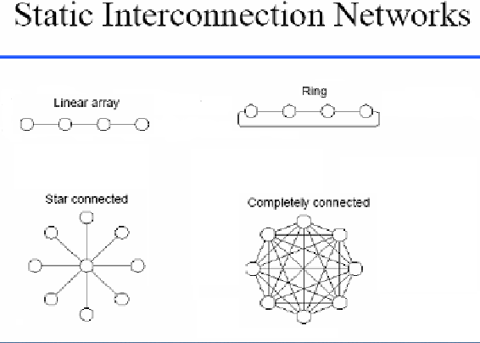

Slide 18
Static Networks – Linear Array
N nodes connected by n-1 links; segments between different pairs of nodes can be used in parallel.
Internal nodes have degree 2; end nodes have degree 1.
Diameter = n-1
Bisection = 1

Slide 19
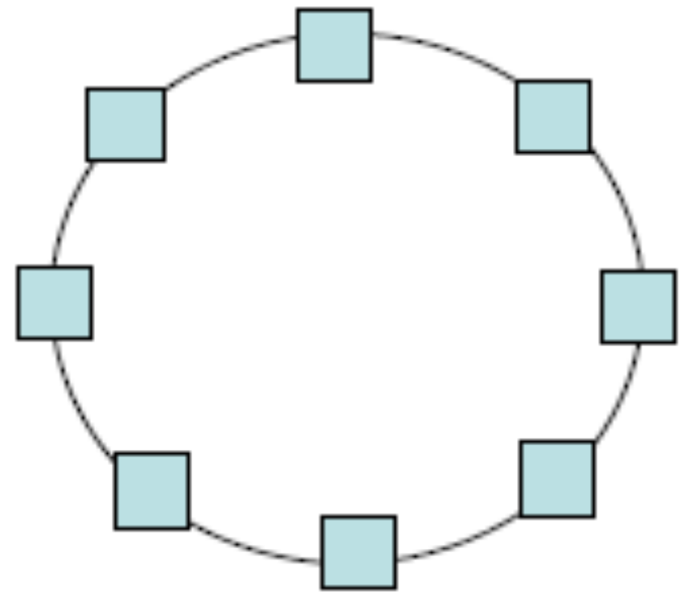
Static Networks – Ring
Like a linear array, but the two end nodes are connected by an n ^{th} link; the ring can be uni- or bi-directional.
Diameter is ⎣n/2⎦ for a bidirectional ring, or n for a unidirectional ring.

Slide 20
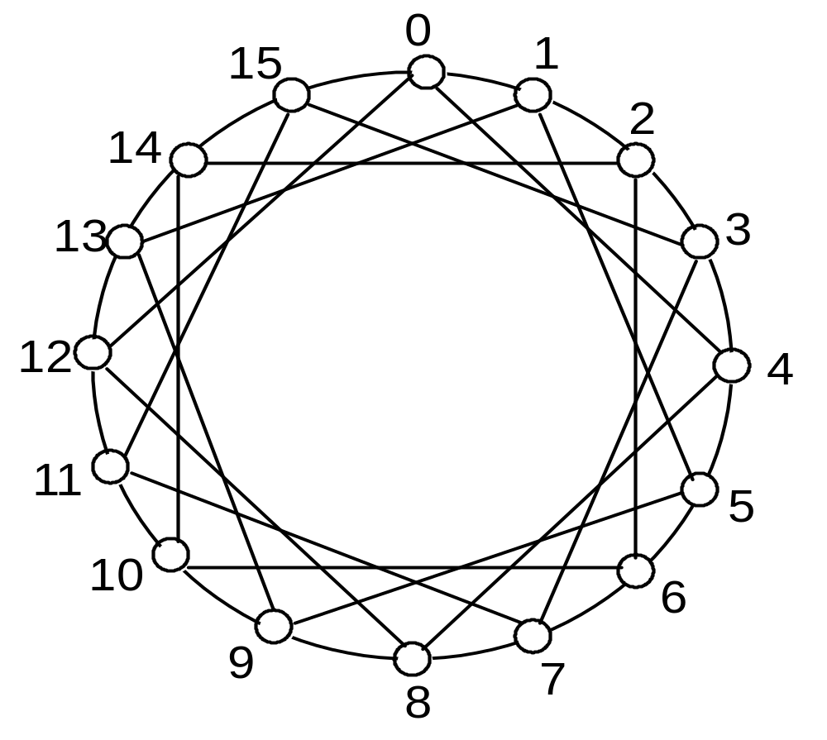
Static Networks – Chordal Ring
By adding additional links (e.g. “chords” in a circle), the node degree is increased, and we obtain a chordal ring. This reduces the network diameter.

Slide 21
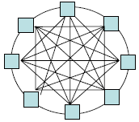
Fully Connected
In the limit, we obtain a fully-connected network, with a node degree of n -1 and a diameter of 1.
1
2
6
3
5
4

Slide 22
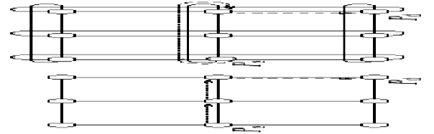
Static Interconnection Networks (2D)
• A n-dimensional mesh [torus or wraparound mesh] is an
extension of the linear array [ring]. Degree: 2-4
• Examples: Intel Paragon (2D mesh),

Slide 23
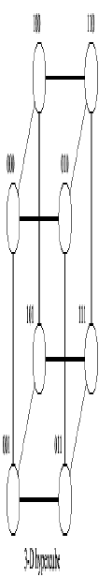
Static Interconnection Networks 3D: Hypercubes
• An hypercube ia multi-dimensional mesh with exactly two processors in each dimension. A n-cube consists of N = 2^{n} nodes. The node degree of n cube equals n and so does the network diameter.

Slide 24
3-cube connected cyclic (CCC) network:
-is obtained from 3-cube n/w. The idea is to cutoff corner nodes of 3-cube and replace each by a cycle of 3 nodes.
CCC n/w is constructed from k-cube with n = 2^{k} cycles nodes.
Hence a 3-cube can be transformed to a 3-CCC with k x 2^{k} nodes.

Slide 25
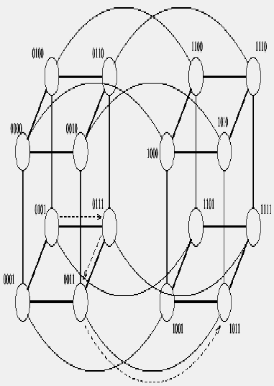
4D hypercube
4D hypercube = two 3D hypercubes with an additional link connecting corresponding processors

Slide 26
Multistage Interconnection Network
Switch Modules
A x B switch module
A inputs and B outputs
In practice, A = B = power of 2
Each input is connected to one or more outputs (conflicts must be avoided)
One-to-one (permutation) and one-to-many are allowed

Slide 27
Multistage Interconnection Network
Switch Modules
A 2 × 2 switch can be configured for
  Straight-through
  Crossover
  Upper broadcast (upper input to both outputs)
  Lower broadcast (lower input to both outputs)

Slide 28
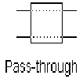


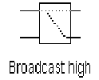
Binary Switch
2x2
Switch
Legitimate States = 4
Permutation Connections = 2

Slide 29
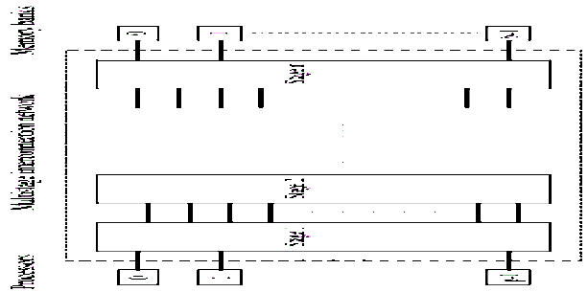
Multistage Interconnection Network
• Multistage networks are a good compromise between cost and performance
– More scalable in terms of cost than crossbar, more scalable in terms of performance than bus
– Popular schemes include omega and butterfly networks
ISC1
ISC2
ISCn

Slide 30
Multistage Networks
Any multistage network is comprised of a collection of a × b switch modules and fixed network modules. The a × b switch modules are used to provide variable permutation or other reordering of the inputs, which are then further reordered by the fixed network modules.
A generic multistage network consists of a sequence alternating dynamic switches (with relatively small values for a and b) with static networks (with larger numbers of inputs and outputs). The static networks are used to implement interstage connections (ISC).

Slide 31
3 Classes:
Blocking
Rearrangeable
Nonblocking
Blocking N/W: Simultaneous connections of more than one terminal pair may result in conflicts in the use of N/W communication links.
Eg. Base line N/W: is generated recursively.

Slide 32
Baseline Network
A baseline network has a simple recursive generation procedure.
The first stage contains one N x N block and second stage two (N/2) x (N/2) subblocks.
The construction process is recursively applied to the subblocks until the N/2 subblock is of size 2 x 2 are reached. The subblocks are straight and crossover between the two inputs and two outputs.

Slide 33
Rearrangeable Nonblocking N/W
Eg. Benes N/W
Nonblocking N/W
Eg. Clos N/W
Design principle of N/W is to be discussed.

